Slide 1
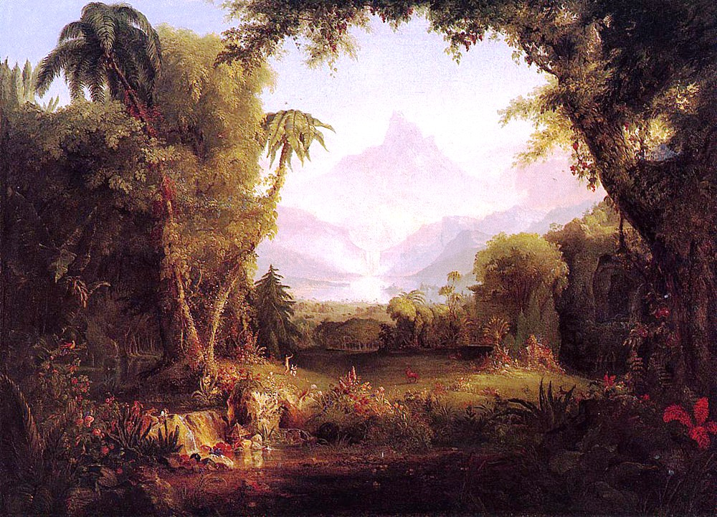
Genesis 1.26-31 Image
Painting by Thomas Cole / from wikiart.org

Slide 2
Genesis 1.26-28 NIV: Then God said, “Let us make mankind in our image, in our likeness, so that they may rule over the fish in the sea and the birds in the sky, over the livestock and all the wild animals, and over all the creatures that move along the ground.” So God created mankind in his own image, in the image of God he created them; male and female he created them. God blessed them and said to them, “Be fruitful and increase in number; fill the earth and subdue it. Rule over the fish in the sea and the birds in the sky and over every living creature that moves on the ground.”

Slide 3
Genesis 1.29-31 NIV: Then God said, “I give you every seed-bearing plant on the face of the whole earth and every tree that has fruit with seed in it. They will be yours for food. And to all the beasts of the earth and all the birds in the sky and all the creatures that move along the ground—everything that has the breath of life in it—I give every green plant for food.” And it was so. God saw all that he had made, and it was very good. And there was evening, and there was morning—the sixth day.

Slide 4
Genesis 1.26: Then God said, “Let us make…”

Slide 5
Genesis 1.26: Then God said, “Let us make mankind in our image, in our likeness…”
Genesis 1.27: So God created mankind in his own image, in the image of God he created them; male and female he created them.

Slide 6
1.28: God blessed them and said to them...
1.29-30: Then God said…
1.31: God saw all that he had made,
and it was very good.

Slide 7
Genesis 1.26:
Then God said, “Let us make mankind in our image, in our likeness, so that they may rule over the fish in the sea and the birds in the sky, over the livestock and all the wild animals, and over all the creatures that move along the ground.”

Slide 8
Genesis 1.26:
Then God said, “Let us make mankind in our image, in our likeness, so that they may rule...”
in God’s name
as God’s image bearers
 by God’s authority
 by God’s will
 by God’s direction
 for God’s glory
bless not exploit

Slide 9
Genesis 1.28: God blessed them and said to them, “Be fruitful and increase in number; fill the earth and subdue it. Rule over the fish in the sea and the birds in the sky and over every living creature that moves on the ground.”

Slide 10
Genesis 1.28: God blessed them and said to them, “Be fruitful and increase in number; fill the earth and [so as to] subdue it. Rule over the fish in the sea and the birds in the sky and over every living creature that moves on the ground.”

Slide 11
Genesis 1.28: God blessed them and said to them, “Be fruitful and increase in number; fill the earth and subdue it...”
Matthew 28.18-20 NIV: Then Jesus came to them and said, “All authority in heaven and on earth has been given to me. Therefore go and make disciples of all nations, baptizing them in the name of the Father and of the Son and of the Holy Spirit, and teaching them to obey everything I have commanded you. And surely I am with you always, to the very end of the age.”

Slide 12
Genesis 1.26: Then God said, “Let us make mankind in our image, in our likeness...”
we are to reflect God’s character

Slide 13
Genesis 1.26: Then God said, “Let us make mankind in our image, in our likeness...”
Colossians 1.15 NIV: The Son is the image of the invisible God…
Romans 8.29 NIV: For those God foreknew he also predestined to be conformed to the image of his Son...

Slide 14
Genesis 1.26: Then God said, “Let us make mankind in our image, in our likeness...”
Ephesians 4.22-24 NIV: You were taught, with regard to your former way of life, to put off your old self, which is being corrupted by its deceitful desires; to be made new in the attitude of your minds; and to put on the new self, created to be like God in true righteousness and holiness.

Slide 15
Genesis 1.26: Then God said, “Let us make mankind in our image, in our likeness...”
 rule creation in God’s name
 reproduce the image of God in others
 reflect God’s character
 represent God in human interactions

Slide 16
God
 reflect
 represent
 reproduce
 rule
Family
Creation

Slide 17
God
God
 reflect
 represent
 reproduce
 rule
Family
Israel
Creation
Nations

Slide 18
God
God
God
 reflect
 represent
 reproduce
 rule
Family
Israel
Church
Creation
Nations
Peoples

Slide 19
God said, “Let us make mankind in our image...”
Therefore every human life is sacred.

Slide 20
God said, “Let us make mankind in our image...”
Therefore you have unalterable
value, purpose, validation, identity, significance…

Slide 21
Genesis 1.26-31
We are God’s image bearers!
Devotion available at groben.com

